Slide 1
Bell Work
Grab a book… we’ll go over homework questions
And get ready for the quiz

Slide 2
From last time…
Pg 176 #9, 19, 27, 31, 44, 71, 77, 113, 118

Slide 3

Unit 2 Quiz 1: Level 2
Identify the max/min and describe end behavior.
1.) $f\left(x\right)=−(x^{2}+2x−3)$
2.) $h\left(x\right)=x^{4}−5x^{2}+4$

Slide 4

Unit 2 Quiz 1: Level 3
Find all Zeros.
$$3.) f\left(x\right)=48x^{3}−80x^{2}+41x−6$$
$$4.) g\left(x\right)=x^{3}−12x−16$$

Slide 5
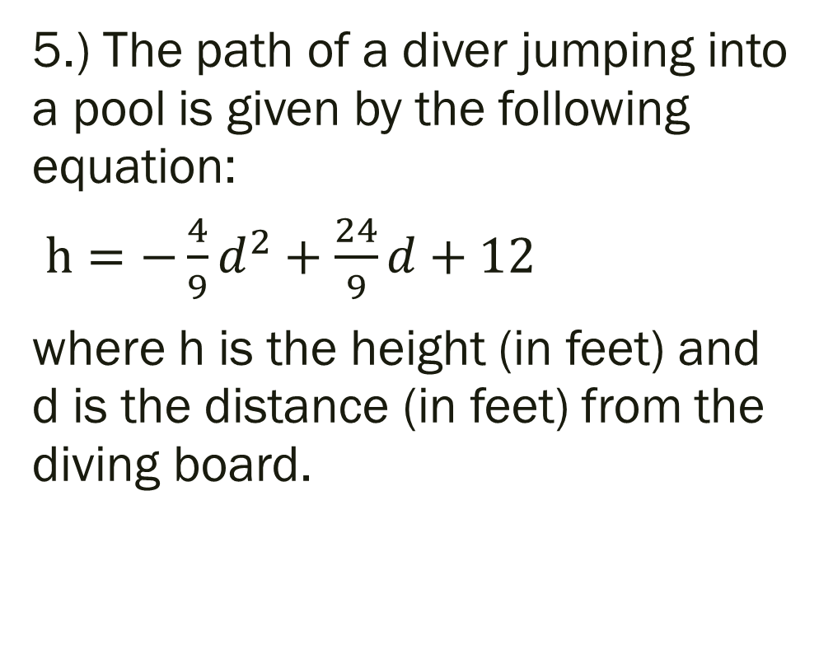
Unit 2 Quiz 1: Level 4
Answer the following:
--What is the maximum height the diver reaches, and how far are they from the board when they reach the max?
--How tall is the diving board?
--How far out into the pool did the diver land?
5.) The path of a diver jumping into a pool is given by the following equation:
$h=−\frac{4}{9}d^{2}+\frac{24}{9}d+12$
where h is the height (in feet) and d is the distance (in feet) from the diving board.

Slide 6
Pre-calc trig
Day 17

Slide 7
2.6 Rational Function
Objective: To identify properties (asymptotes) of rational functions To graph rational functions and state domain
HLQ: What are the similarities and differences between a hole and a vertical asymptote? What impact does this have on our domain?

Slide 8

Forms of Rational Functions
$f\left(x\right)=\frac{P(x)}{Q(x)}$

Slide 9
Key Terms
Vertical Asymptote: set denominator equal to 0 and solve for x
Horizontal Asymptote: -- if degree in numerator is smaller than degree in the denominator: y=0 -- if degree in numerator is bigger than degree in the denominator: no horizontal asymptote -- if degree is equal then horizontal asymptote is a/c

Slide 10
Types of Graphs
Continuous Graph: the graph is “nonstop” there are no jumps or breaks or holes in the graph (you can draw it without picking up your pencil from the paper)
Discontinuous Graph: there is a jump or break or hole in the graph because some value makes the denominator equal zero
Point of Discontinuity: the x value that makes the denominator zero
Removable Discontinuity: you can redefine the function so that you can find a value of the point of discontinuity by simplifying the function
Non-Removable Discontinuity: there is no way to redefine the function to find the value of the point of discontinuity

Slide 11
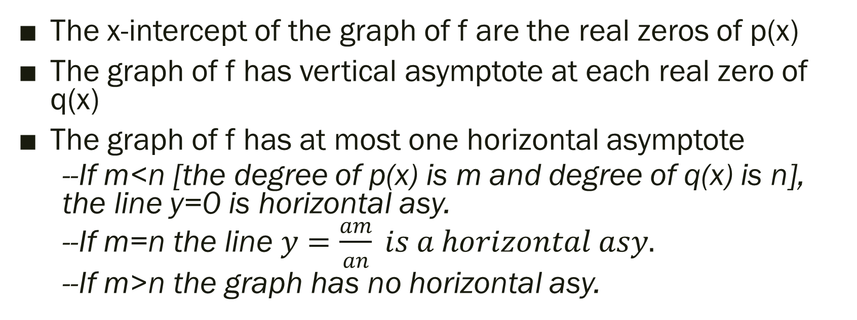
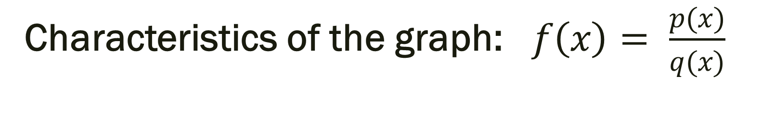
Characteristics of the graph: $f\left(x\right)= \frac{p(x)}{q(x)}$
The x-intercept of the graph of f are the real zeros of p(x)
The graph of f has vertical asymptote at each real zero of q(x)
The graph of f has at most one horizontal asymptote
--If m<n [the degree of p(x) is m and degree of q(x) is n], the line y=0 is horizontal asy.
--If m=n the line $y=\frac{am}{an} is a horizontal asy.$
--If m>n the graph has no horizontal asy.

Slide 12
Steps to Graphing:
1) Draw the asymptotes
2) Plot 2 or 3 “smart” points on each side of the vertical asymptote
3) Use points and asymptotes to draw branches
**Or just use the calculator PLEASE!

Slide 13

Graph and State Domain and Range
$y=\frac{(x+3)(x+2)}{x+2}$
$y=\frac{x+3}{x^{2}−4x+3}$

Slide 14
For next time…
Page 190 #9-15(odd), 21, 25, 27, 41, 43, 79

